Slide 1
AGE AND GENDER PREDICTON USING MACHINE LEARNING
BY :
M. HARIHARAN

Slide 2
INTRODUCTION
Facial analysis from images has gained lot of interest because it helps in several different problems like better ad, targeting for customers, better content recommendation

Slide 3
FACIAL RECOGNITION
Age and gender information are very important for various real world applications, such as social understanding, biometrics, identity verification, video surveillance etc.,
According to the Markets and Markets report, the facial recognition technology market is predicted to reach $7 billion by 2024, and demonstrate a CAGR of 16.6% over the period from 2019 to 2024. (Markets And Markets –A Company offers market research reports)
This provides a unique opportunity to gain valuable insight and build stronger relationships with customers .
The times of focus groups and customer surveys are beginning to fade; forced, biased responses often resulted in less accurate results.
COURTESY :https://www.getalfi.com/advertising/facial-recognition-advertising-future-is-here/

Slide 4

EXAMPLE
Now, some billboard setups feature cameras built into the unit itself, while others have cameras set up in nearby areas or shopping centers.
These large-scale ad spaces can be outfitted with powerful, dynamic technology capable of identifying gender, facial expression, age, and the makeup of passing crowds.
After detection and analysis, the billboard has the ability to produce programmed responses, content, or videos that change depending on the gender, age, and mood of a pedestrian, for example
COURTESY :https://www.getalfi.com/advertising/facial-recognition-advertising-future-is-here/
FIG: BILLBOARD

Slide 5
DATASETS AND DATA PREPROCESSING
UTK datasets is downloaded from kaggle for this project for predicting age and gender.
data is actually image .data is resized to standard size of 32*32 to make all same and gray scaled to eliminate rgb channel.
then ,the 2 dimensional array is flattened to 1 dimensional array.
label of data is obtained from file name.
better performed model is saved and deployed

Slide 6
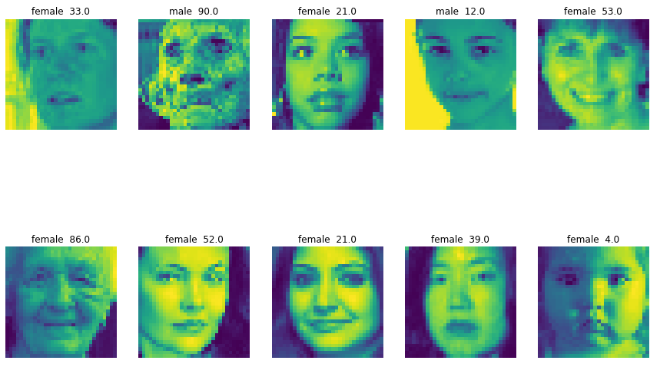
SAMPLE OF DATA AFTER CLEANING
TITLE SAYS ABOUT GENDER AND AGE OF THE FILE

Slide 7
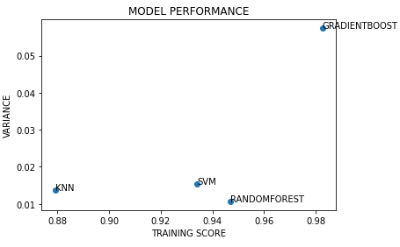
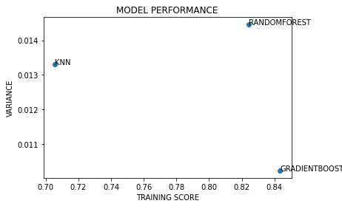
MODEL PERFORMANCE
THE PROBLEM COMES UNDER CLASSIFICATION PROBLEM
AGE AS TARGET VARIABLE
GRADIENBOOST PERFORMS WELL WITH 98% ACCURACY
GENDER AS TARGET VARIABLE
GRADIENBOOST PERFORMS WELL WITH 84% ACCURACY

Slide 8
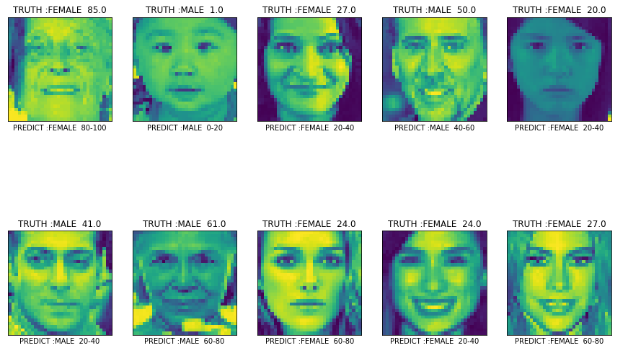
MODEL PERFORMANCE ON DATA
FIG: PERFORMACE OF MODEL ON INDIVIDUAL DATA

Slide 9
THANK YOU
NOTEBOOK LINK:
https://github.com/Hariharanmadheswaran/GUVI_DATA_SCIENCE_PROJECTS/tree/main/CLASSIFICATION

